Slide 1


Congregation of Daughters of Mary (DM)
Towards Laudato si

Slide 2
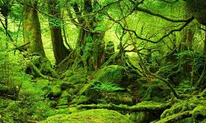
Protect the Earth,
Dignify Humanity

Slide 3
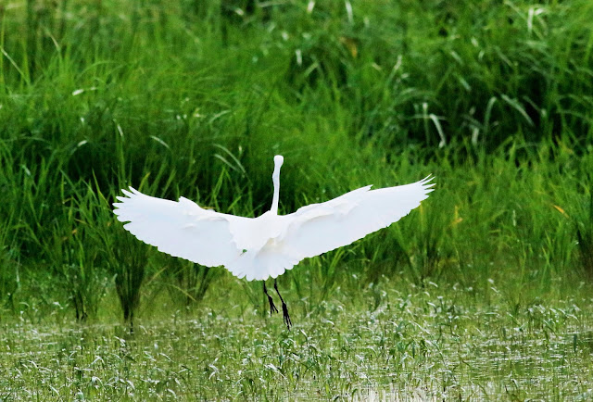
Improve the status of biodiversity by safeguarding ecosystems,
species, and genetic diversity
To

Slide 4
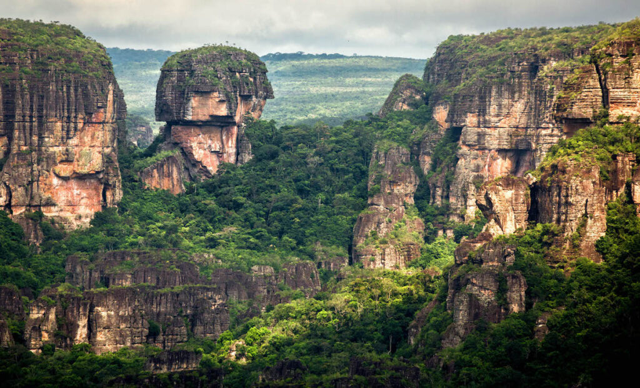
Ecology based on “respect
for the human person as such, endowed with basic and
inalienable rights ordered to his
or her integral development.
Our mission is to educate and empower the next generation

Slide 5
Environment friendly Indian culture
In Rig Veda it is mentioned that universe consists of five basic elements namely Earth, Water, Air, Fire and Space (Ether). These five elements provide basis for life in everything and man is ordained to conserve them.

Slide 6
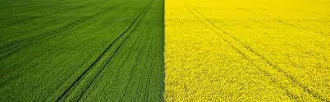
During the puranic period (320 BC on ward) a popular belief emerged that each tree had its own deity. People offered water and circled trees with sacred threads in order to protect them.

Slide 7
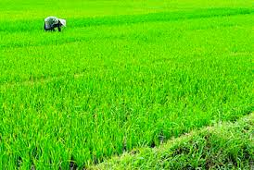
Favorable practices in Indian culture
for safeguarding the earth
In Indian astrology, each of the twenty-seven nakshatras, from Aswati to Revati, is assigned
an animal, bird, tree and element.
It is believed that if those born on each day
do not destroy them, but nurture
and grow them, they will have longevity,
health, and prosperity.

Slide 8
Favorable practices in Indian culture
for safeguarding the earth
No | Stars | birds | Animals | Element | Trees and | Scientific Name
1 | Aswathi | Peregrine | Horse | Earth | Kanjiram | Stychnos nux
2 | Bharani | Peregrine | Elephant | Earth | Nelli | Phyllanthus emblica
3 | Karthika | ” (പുള്ള്) | Goat | Earth | Aththi | Ficus racemosa
4 | Rohini | ” | Snake | Earth | Jnaval | Syzygium cumini
5 | Makayiram | ” | Snake | Earth | Karingali | Acacia catechu
6 | Thiruva- thira | Crow pheasant | Dog | Water | Karimaram | Diospyros candolleana
7 | Punartham | ” | Cat | Water | Mula | Bambusa arundinacea
8 | Pooyam | ” | Goat | Water | Arayal | Ficus religiosa
9 | Ayilyam | ” | Cat | Water | Nakamaram | Musua ferrea

Slide 9
Favorable practices in Indian culture
for safeguarding the earth
No | Stars | Birds | Animals | Element | Trees and | Scientific Name
10 | Makam | Crow pheasant | Rat | Water | Peral | Ficus benghalensis
11 | Pooram | ” | MICE | Earth | Chamatha | Butea monosperma
12 | Uthram | Crow | Camel | Fire | Iththi | Ficus microcarpa
13 | Aththam | ” | Buffalo | Fire | Ambazham | Spondias mangifera
14 | Chiththira | ” | leopard | Fire | Koovalam | Aegle marmelos
15 | Chothi | ” | Buffalo | Fire | Neermaruth | Terminalia arjuna
16 | Visakham | ” | lion | Fire | vayankatha | Flacourtia montana
17 | Anizham | ” | deer | Fire | Ilanji | Mimusops elengi
18 | Keta | chicken | deer | Air | vetti | Aporosa lindleyana

Slide 10
Favorable practices in Indian culture
for safeguarding the earth
No | Stars | Birds | Animal | Element | Trees and | Scientific Name
19 | Moolam | Chicken | Dog | Air | White pine | Vateria indica
20 | Puradam | ” | Monkey | Fire | Vanchi tree | Salix tetrasperma
21 | Utradam | ” | Ox | Air | Plavu | Artocarpus heterophyllus
22 | Thiruvonam | ” | Monkey | Air | Erikku | Calotropis gigantea
23 | Avittom | Peacock | Nallal | Sky | Vanni | Prosopis spicigera
24 | Chathayam | ” | Horse | Sky | Kadambu | Anthocephalus candamba
25 | puruttathi | ” | Cow | Sky | Mavu | Mangifera indica
26 | Uthruttathi | ” | Cow | Sky | Karimbana | Borassus flabellifer
27 | Revathi | ” | Elephant | Sky | Ilippa | Madhuca longifolia

Slide 11
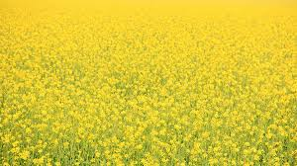
MAJOR ENVIRONMENTAL ISSUES
Climate Change Environmental degradation Intensive farming Land degradation Nuclear issues Overpopulation Ozone depletion Pollution Resource depletion

Slide 12
Major environmental movements in India
1.Bishnoi Movement
2. Chipko Movement
3. Save Silent Valley Movement
4. Jungle Bachao Andholan
5. Appiko Movement
6. Narmada Bachao Andholan (NBA)
7. Tehri Dam Conflict

Slide 13
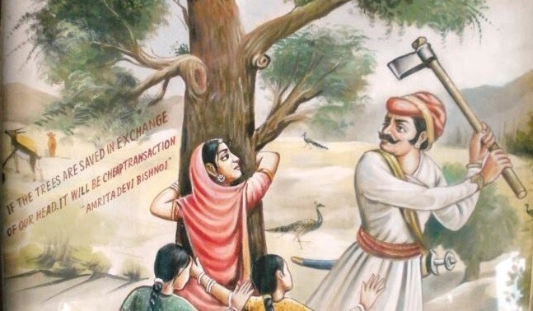
Environmental
movements
in India
1.Bishnoi Movement
Amrita Devi, a female villager could not bear to witness the destruction of both her faith and the village’s sacred trees. She hugged the trees and encouraged others to do the same. 363 Bishnoi villagers were killed in this movement.

Slide 14
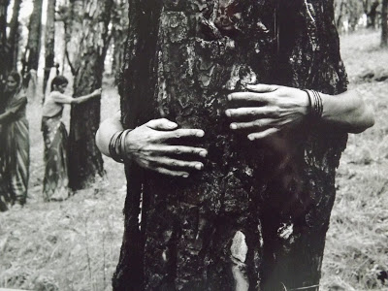
Environmental
movements
in India
2. Chipko Movement
Mr. Bahuguna enlightened the villagers by conveying the importance of trees in the environment which checks the
erosion of soil, cause rains and provides pure air. The women
of Advani village of Tehri-Garhwal tied the sacred thread
around trunks of trees and they hugged the trees, hence it was called the ‘Chipko Movement’ or ‘hug the tree movement’.

Slide 15
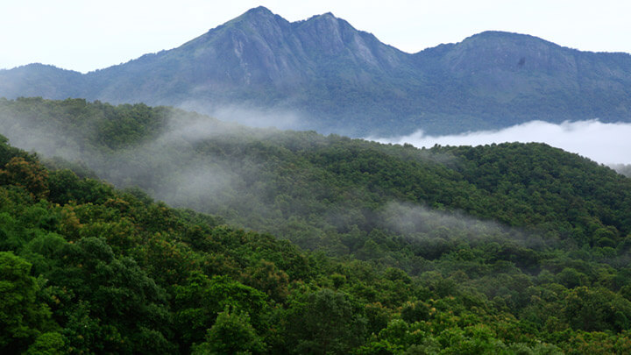
Environmental
movements
in India
3. Save Silent Valley Movement
The Kerala State Electricity Board (KSEB) proposed a hydroelectric dam across the Kunthipuzha River that runs through Silent Valley. In February 1973, the Planning Commission approved the project at a cost of about Rs 25 crores. Many feared that the project would submerge 8.3 sq km of untouched moist evergreen forest. Several NGOs strongly opposed the project and urged the government to abandon it.

Slide 16
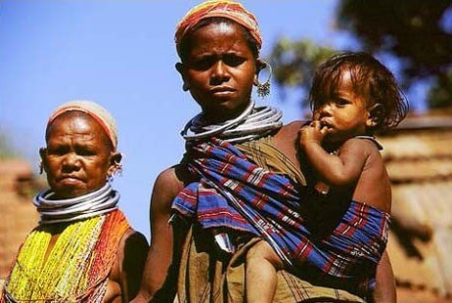
Environmental
movements
in India
4. Jungle Bachao Andholan
The tribals of the Singhbhum district of Bihar started the protest when the government decided to replace the natural sal forests with the highly-priced teak. This move was called by many “Greed Game Political Populism”. Later this movement spread to Jharkhand and Orissa.

Slide 17

Environmental
movements
in India
5. Appiko Movement
The locals embraced the trees which were to be cut
by contractors of the forest department. The Appiko movement used various techniques to raise awareness such as foot marches in the interior forest,
slide shows, folk dances, street plays etc.

Slide 18
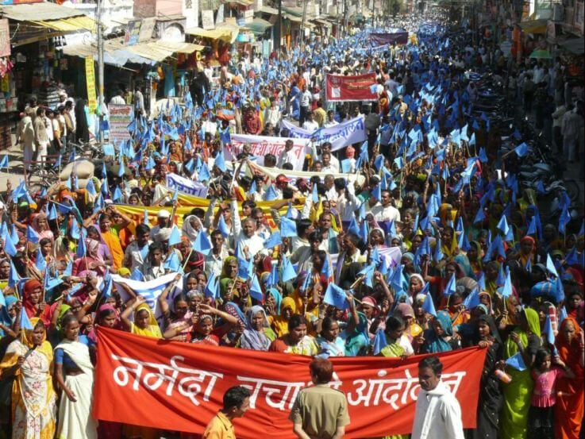
Environmental
movements
in India
6. Narmada Bachao Andholan (NBA)
The movement first started as a protest for not providing proper rehabilitation and resettlement
for the people who have been displaced by the construction of the Sardar Sarovar Dam.

Slide 19
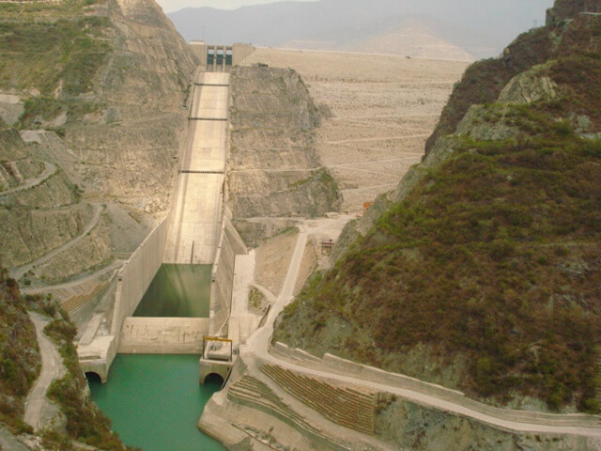
Environmental
movements
in India
7. Tehri Dam Conflict
The protest was against the displacement of town inhabitants
and the environmental consequence
of the weak ecosystem.

Slide 20

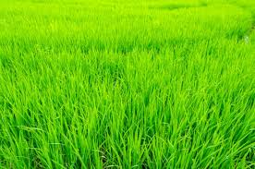
THE MAJOR
ENVIRONMENTAL
MOVEMENTS
IN KERALA
Silent Valley Movement
Mullaperiyar Dam Issue
Save Chaliyar Movement
Movement against Endosulfan
Movement against Coco-Cola

Slide 21
Kerala is widely well known as the ‘God’s own country’ because of its scenic beauty and biodiversity. But the multinational companies have exploited the natural resources of Kerala after globalization.  In Kerala, the
nature lovers, environmental activists, Adivasis or
Tribal people, the poor and the marginalized people
launched various movements against polluting industries, pesticides, construction of dams etc.,  They have defended their environment and their concern is with livelihood, environmental justice and protection, thereby contributed
to the sustainability of the economy.

Slide 22
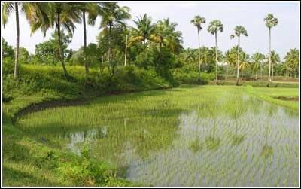
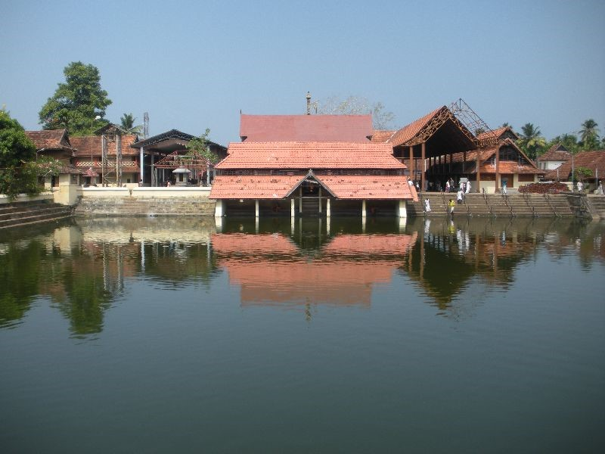
Favorable practices in Kerala culture
for safeguarding the earth
Known as “the rice bowl
of Kerala,” Kuttanad is one of two places in the world where agriculture is practiced below sea level.
A temple pond

Slide 23
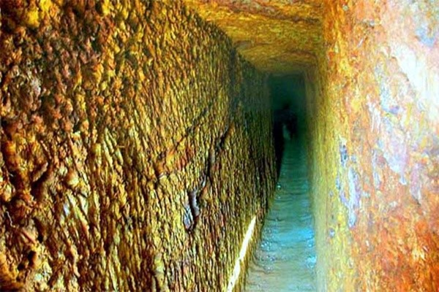
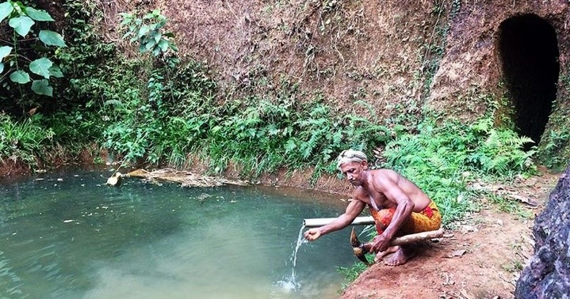
Favorable practices in Kerala culture
for safeguarding the earth
Water from Surangam collected in a sump
The suramgams with 0.45-0.70 m width, 1.8-2.0 m height and length of 3-300 m.

Slide 24
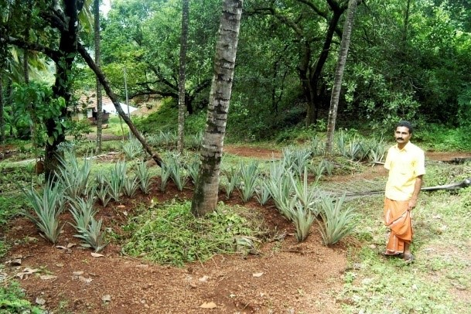
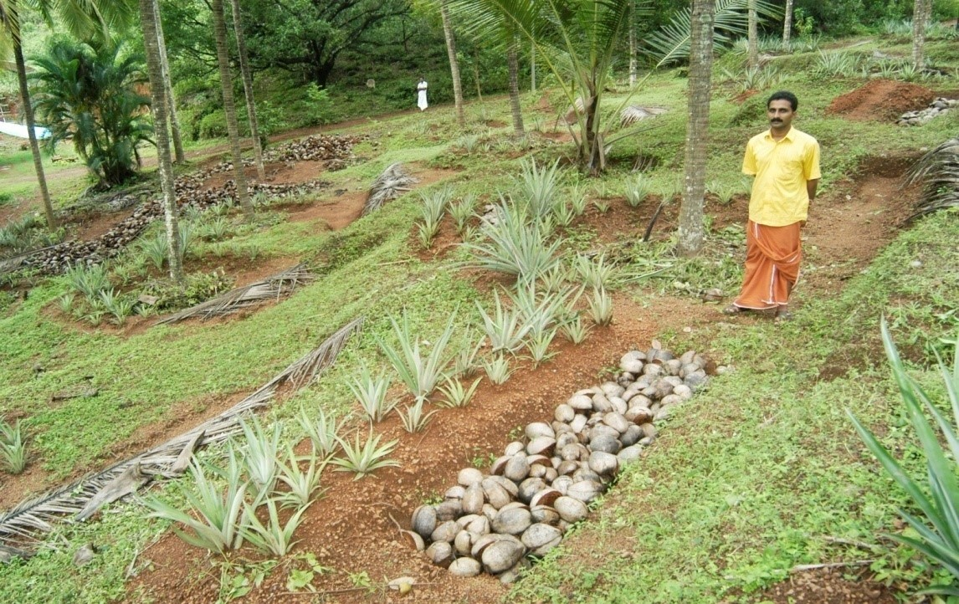
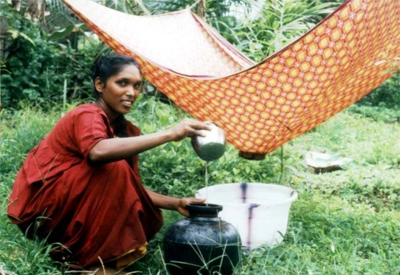
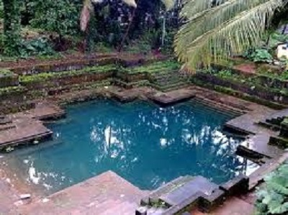
Favorable practices in Kerala culture for safeguarding the earth
traditional rain water harvesting structure in Kerala

Slide 25

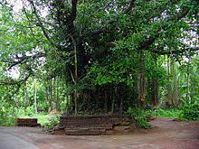
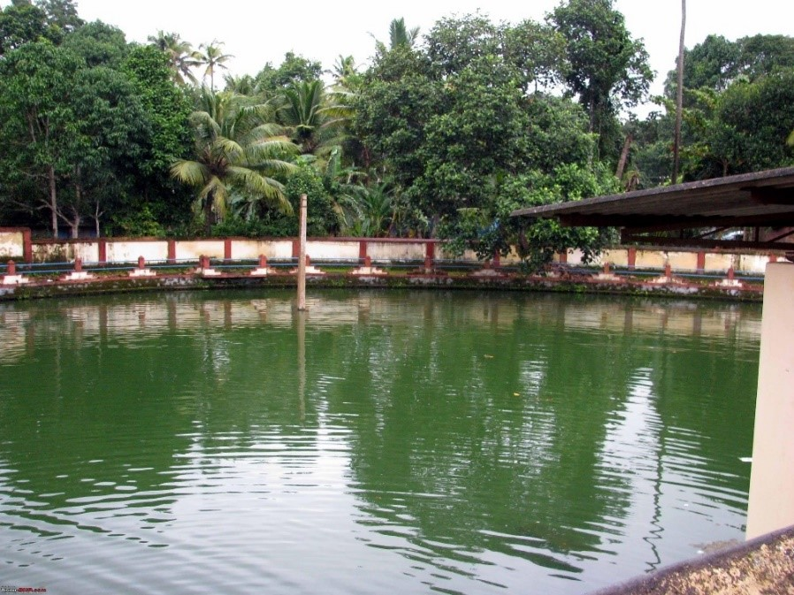
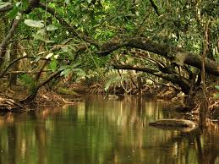
Sacred groves (Kavukal)
with different types of flora such as mangroves, freshwater swamps, mixed trees, medicinal herbs and so on.

Slide 26
ENVIRONMENTAL ISSUES
OF KERALA
  Ground water quality problem In coastal areas
  Uncontrolled Mining of sands
  Affluent from industries Soil erosion salination
  Use of fertilizers and pesticides.
  noise polution are due to automobiles
  Death of rivers abd Flood
  Coastal erosion
  Plastic pollution

Slide 27


Slide 28
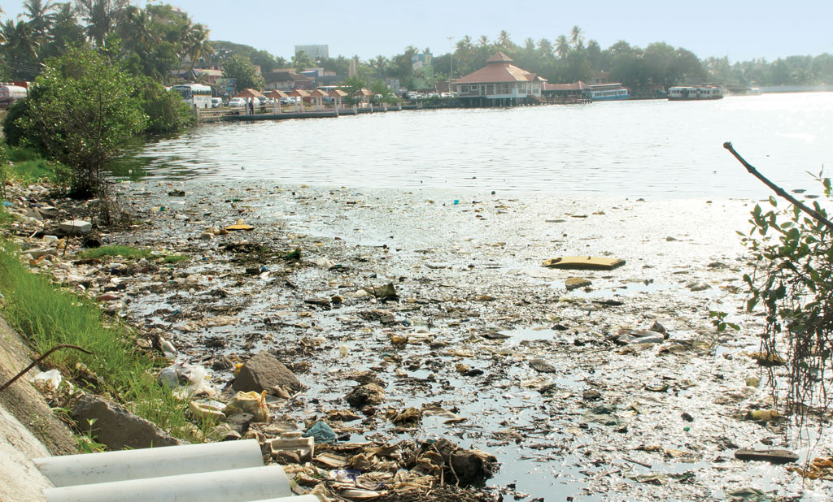
Deterioration Of Water quality
The major problems associated with rivers and open well is pollution.
The dumping of solid waste, bathing, discharge of affluent, law PH, high iron etc also create problems.
Pollutted Lake

Slide 29
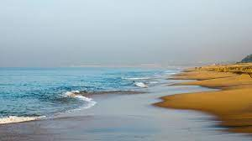
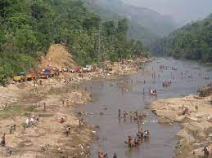
Ground water quality problem In coastal areas
Death of rivers

Slide 30
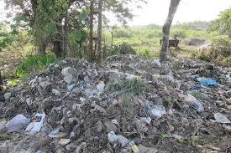
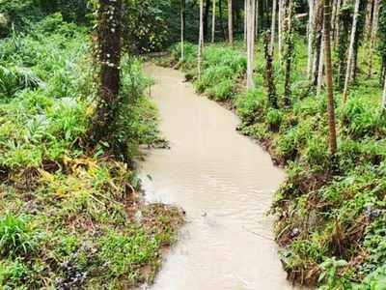
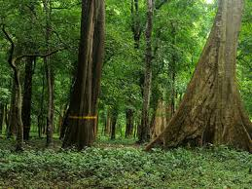
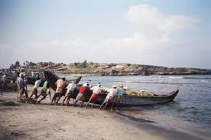
Dumping of quarry waste and slurry in streams.
Plastic pollution
Losing its forest cover
Uncontrolled sand mining

Slide 31
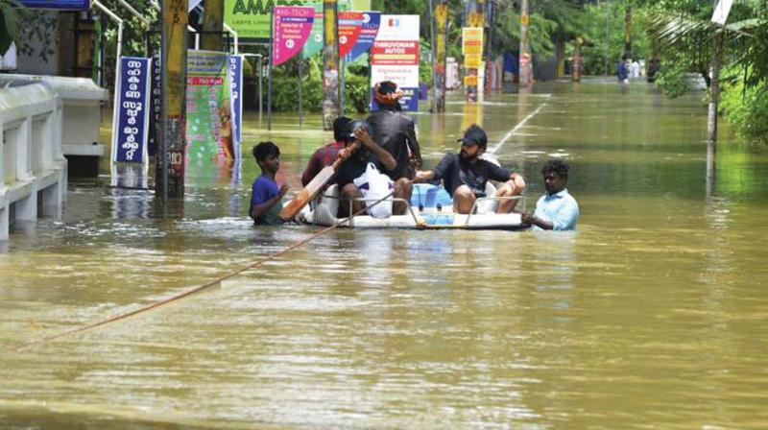
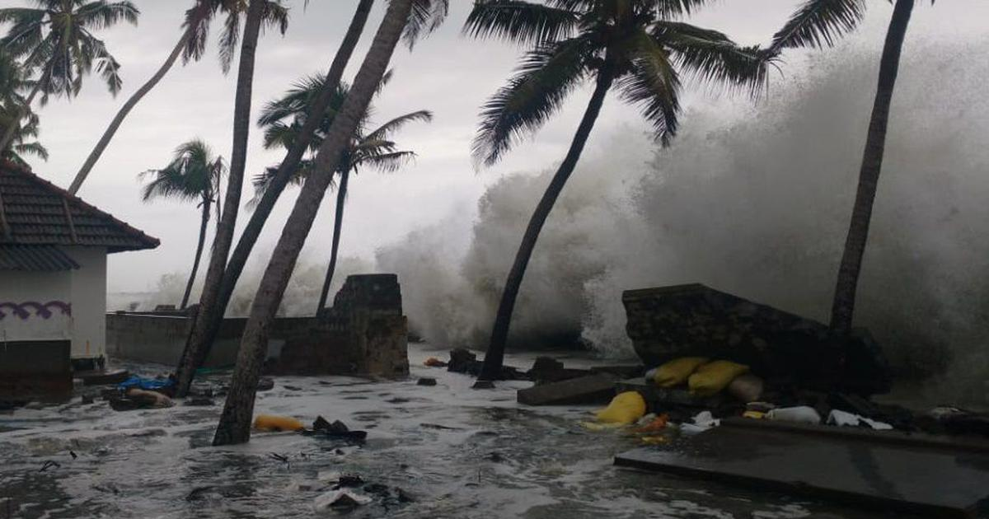
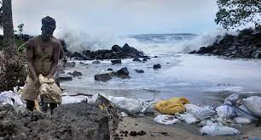
Natural disasters
Ockhi was Kerala’s
fourth cyclone since 1891

Slide 32
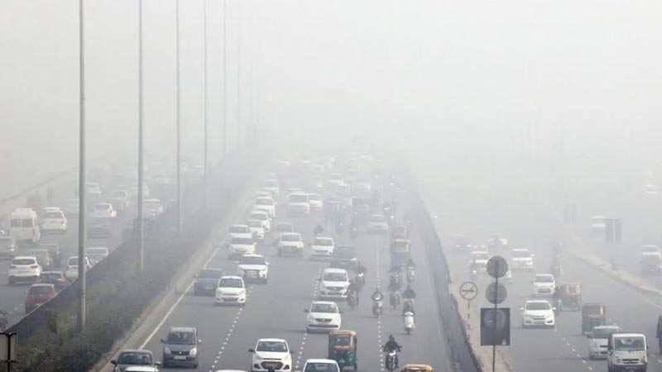
Vehicular emission and noise From this vehicles
Are sever in the three major cities
of kerala
It resulted diseases like head ache, lung disease, vomiting and heart disease etc.

Slide 33

Adani-backed Port Construction in Vizhinjam: Kerala Fisherfolk Protest
Port construction causing increased
sea erosion in the area

Slide 34
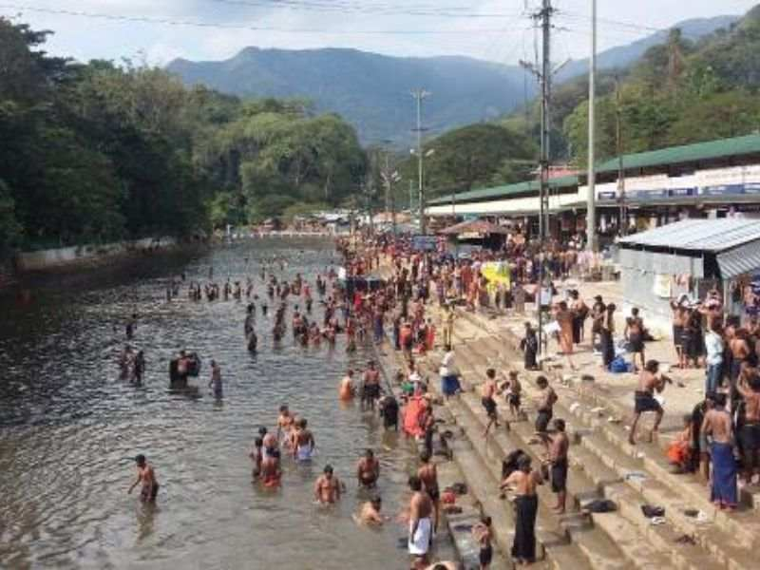
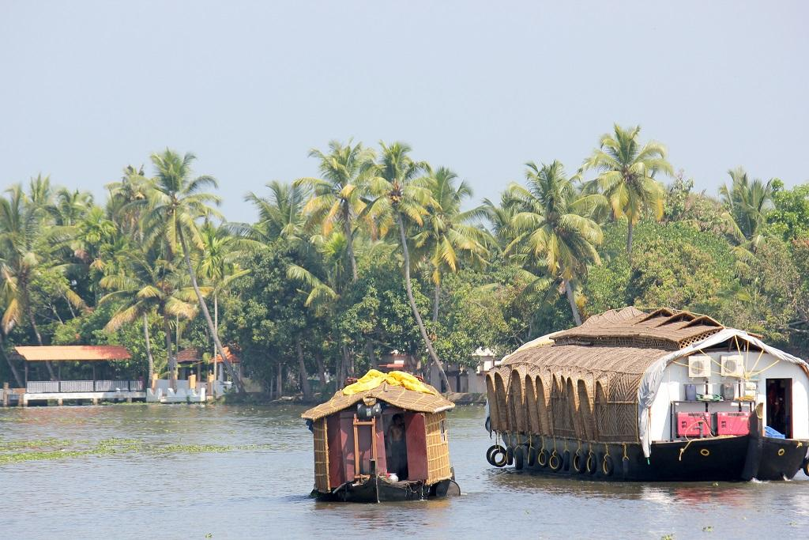
Growing Pollution Rates of the
Pamba River
Phosphorus loads from detergents were found
at 5.6 kg per hectare
per year in the same area

Slide 35

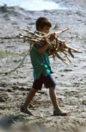
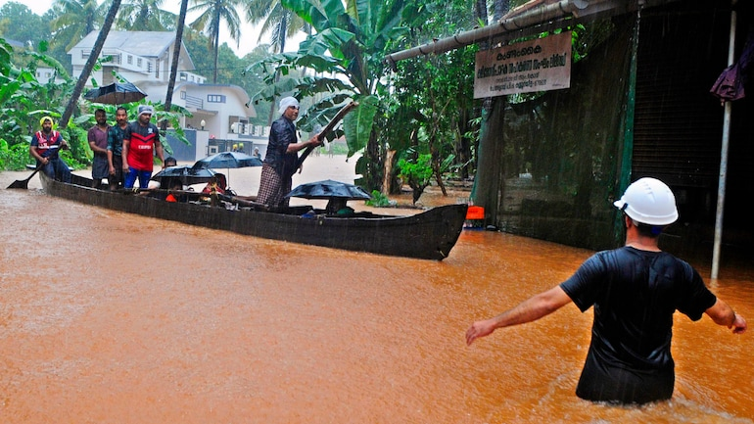
Global Warming and Climate change
Kerala

Slide 36
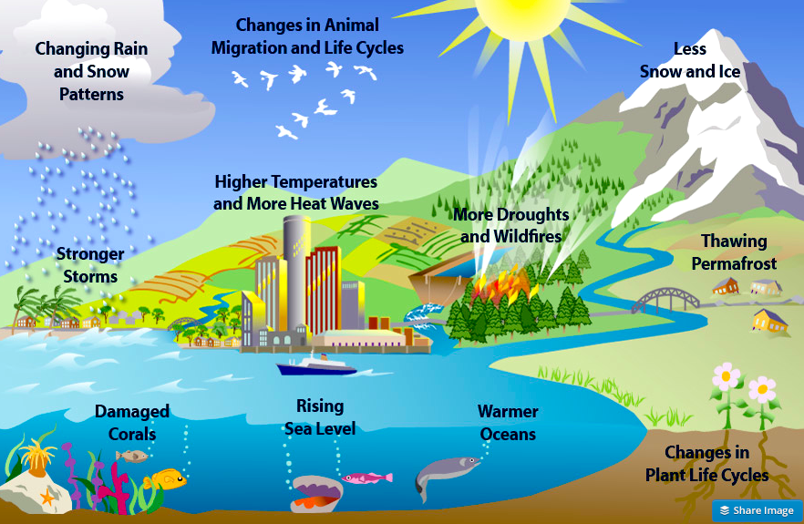

Slide 37

The major cause for the loss
of biodiversity
is due to the degradation of native agricultural eco system, mechanized farming, large conversation of agricultural land, unregulated and illegal harvest, forest fire, soil erosion etc.

Slide 38

We, Daughters of Mary, believe that
Man, as a part and parcel of the environment,
has to recognize the role and importance of the environment in order to protect it and to get
protection from it. Because of that, environmental education is an age-old mission of the
Congregation of Daughters of Mary.

Slide 39


Slide 40


1. Response to the cry of the earth
We become aware of the problems the planet is facing, including climate change, pollution, ocean acidification, and extensive habitat degradation.

Slide 41
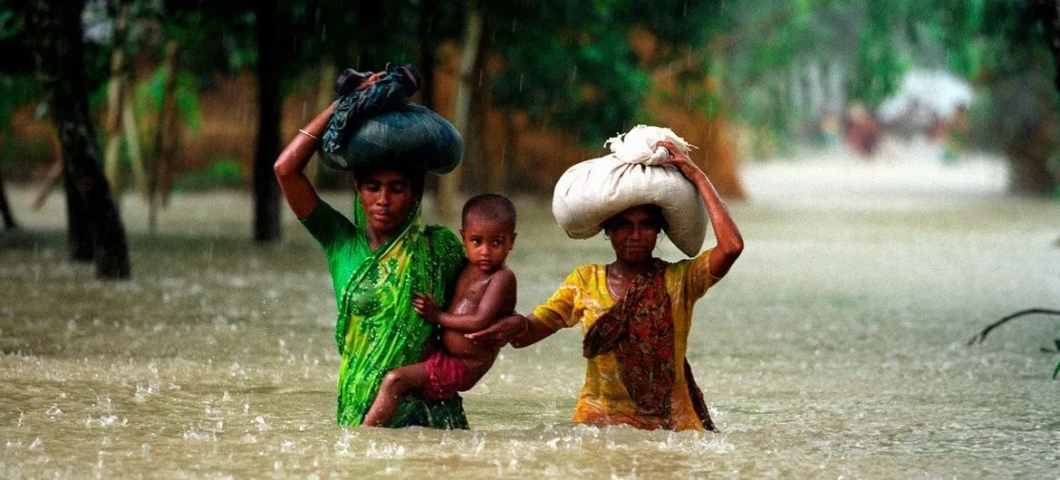
2. Response
to the cry
of the poor
We are conscious that we have a responsibility to protect all Earthly life, including human life from conception to natural death.

Slide 42
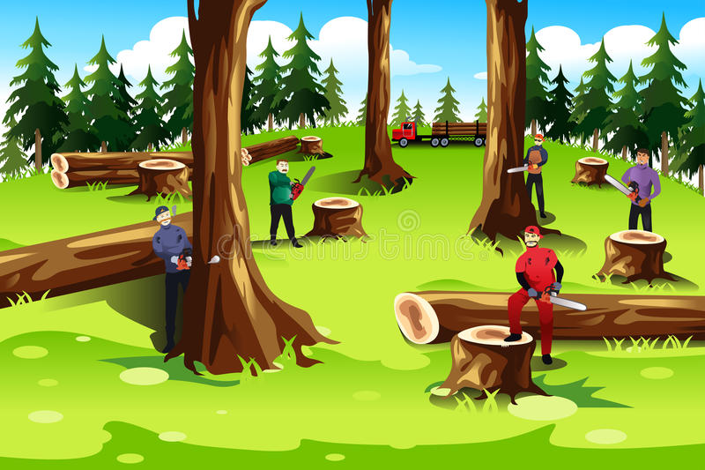
3. Ecological economics
We are conscious that it is important to produce and consume goods and food without
harming the environment.

Slide 43
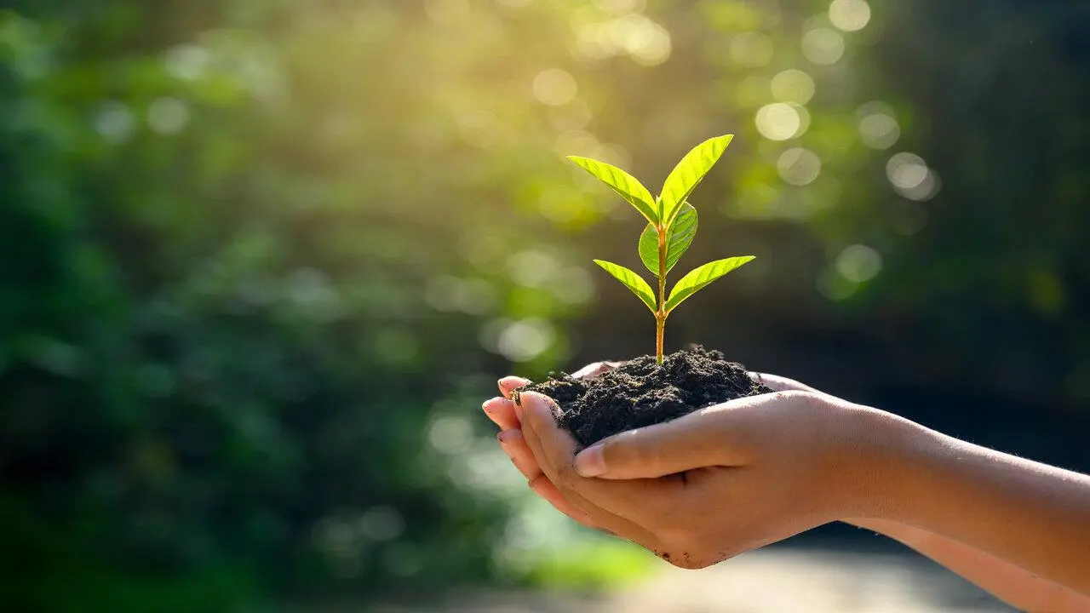
4. Adoption
of sustainable lifestyles
We are conscious that we must live humbly and use our natural and personal resources sparingly.

Slide 44

5. Ecological education
We understand the importance of promoting ecological awareness and
radical change.

Slide 45

6. Ecological spirituality
We are conscious that there is a spiritual connection between human beings and the planet Earth. We are human beings having a spiritual experience.

Slide 46
7. Community resilience and empowerment
We are conscious that we need to organize and strengthen our community if we want to conserve ecosystems.

Slide 47

All living beings
interact very closely with environment. However, only human beings have the capacity to change environment, often with deleterious effects to themselves
and other living beings.
Reflections

Slide 48

Laudato si in Action As a DM Sister
1. I like to spare two hours
for vegetable and flower gardening per day.
I like to make beautiful new things from waste materials.
I am pledging to minimize the use of plastic materials
and practice a minimum
waste policy.

Slide 49
Laudato si in Action As a DM Sister
4. I am using maximum possibilities to finding out the fund for the integral growth
of the poor.
5. I am honouring the dignity
of the person and safeguarding it.
6. I am enjoying educating fami- lies and educational institutions about environmental issues.

Slide 50
Laudato si in Action As a DM Sister
7. I am giving training to promote alternative health systems.
8. Using Poetry and Music to Praise Our Creator, God
9. I am praying for people who are in difficult situations.
10. Contemplating the Beauty and Intricacies of the Natural World
11. I am trying to learn more about the local eco-system.

Slide 51

The Christian vision
of creation care is rooted in Scripture. Jesus taught that the most important commandments are to love God with our whole heart, soul, mind, and strength, and to love our neighbors as ourselves.

Slide 52


Biblical basis of our concern for human dignity and care for earth
The earth mourns and withers; the world languishes and withers; the highest people of the earth languish. The earth lies defiled under its inhabitants; for they have transgressed the laws, violated the statutes, broken the everlasting covenant (Isiah 24: 4-5)

Slide 53
Biblical basis of our concern for human dignity and care for earth
We know that the whole creation has been groaning as in the pains of childbirth right up to the present time (Romans 8,22)

Slide 54

I am committed,
To Promote renewable energy
To Defend water as a common good.
To Promote care for lakes, rivers, and oceans.
To Provide others with plants and Promote organic agriculture, aquaculture, animal husbandry, native birds, and animals

Slide 55
I am committed,
To Promote the planting of
trees, native plants, and seeds
To promote organic agriculture, aquaculture, animal husbandry, native birds, and animals
To celebrate Environmental Day in communities and apostolates.
To Oppose the polluting projects and business-minded agriculture.

Slide 56
As bearers of God’s image, all people have the responsibility and privilege of caring for God’s creation.
Christians in particular
should be motivated by Scripture.
We ought to love and care for the
Earth because it is God’s very good creation, and because we must care for the most vulnerable people on the planet.
most vulnerable people on the planet.

Slide 57


