Slide 1
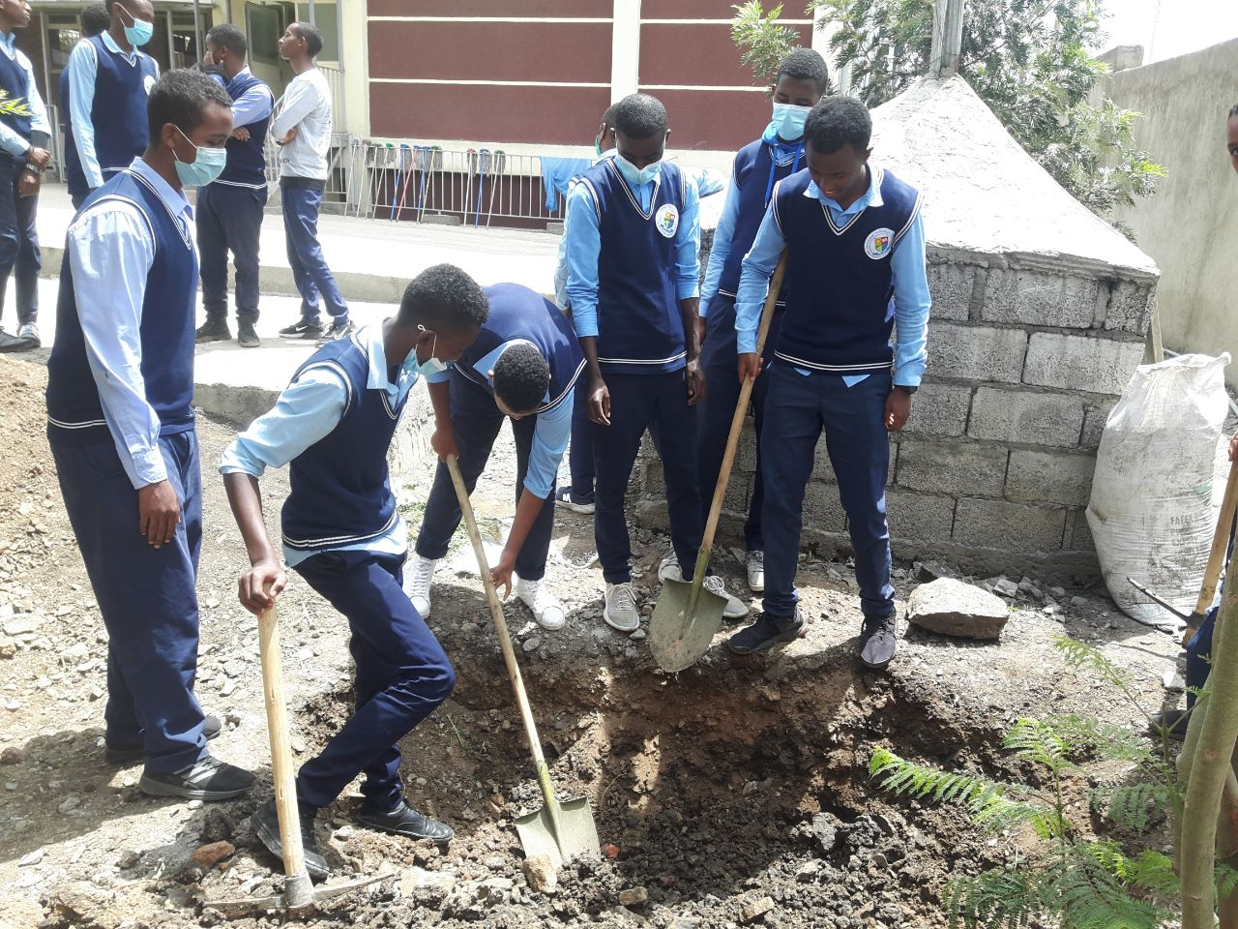
AES
Working in Progress
Laudato Sì !

Slide 2
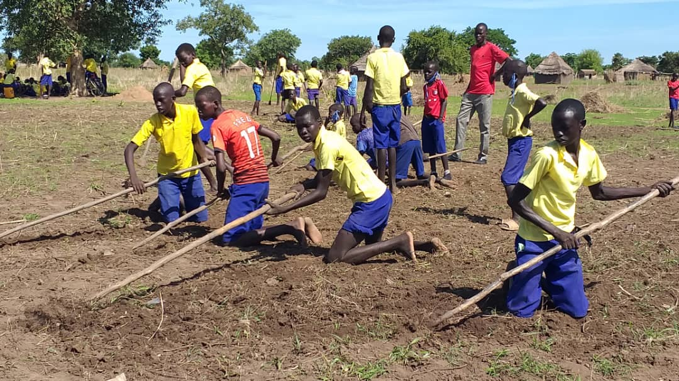
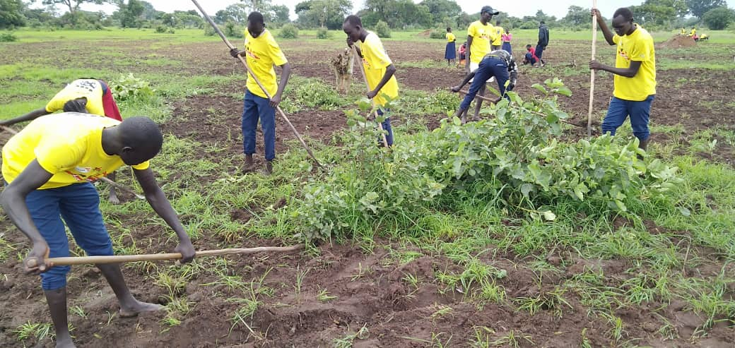
Cry of the earth
Tonj
Take care of garden

Slide 3
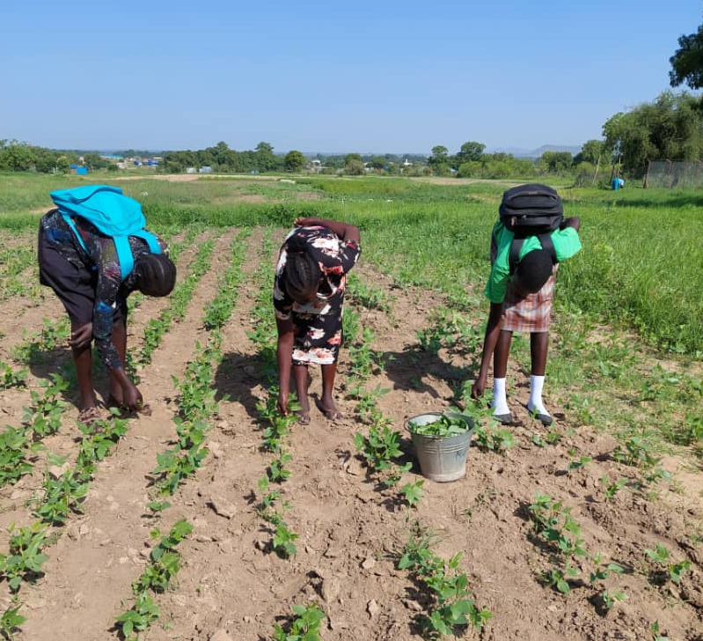
Cry of the earth
Gumbo
Take care of garden

Slide 4
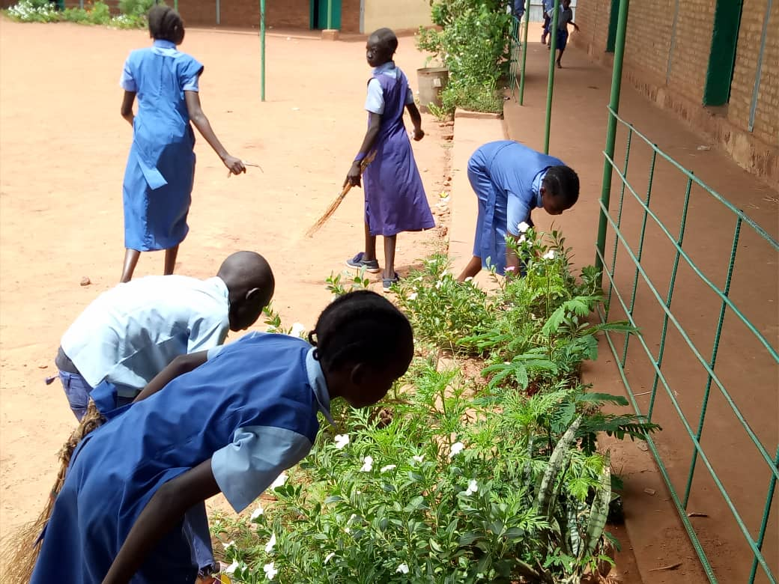
Cry of the earth
Wau
Attention for the nature
Take care of garden

Slide 5
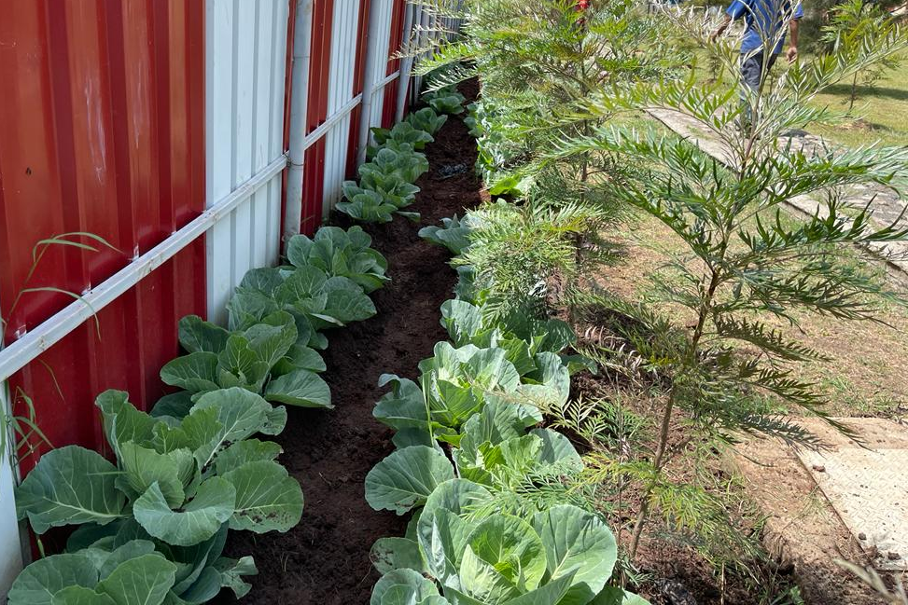
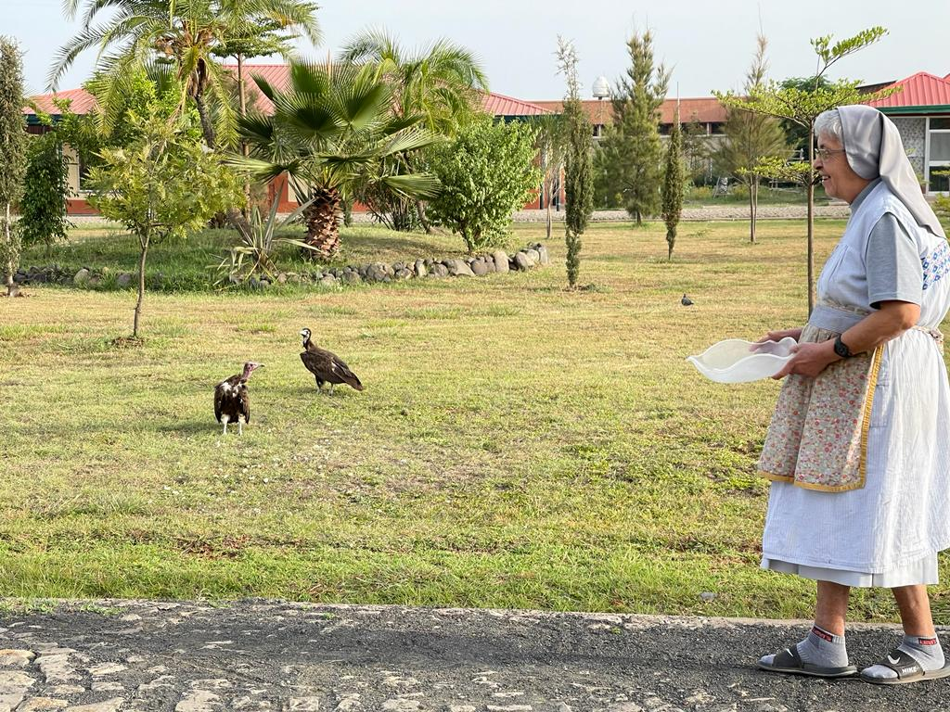
Cry of the earth
Gubrie
Take care of garden

Slide 6
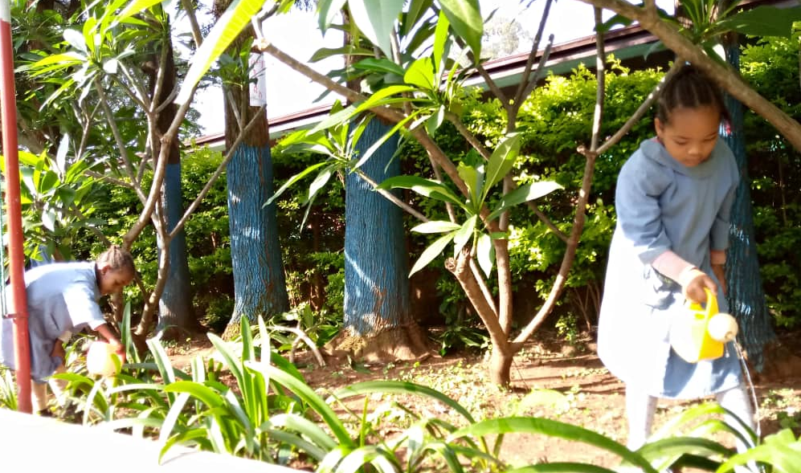
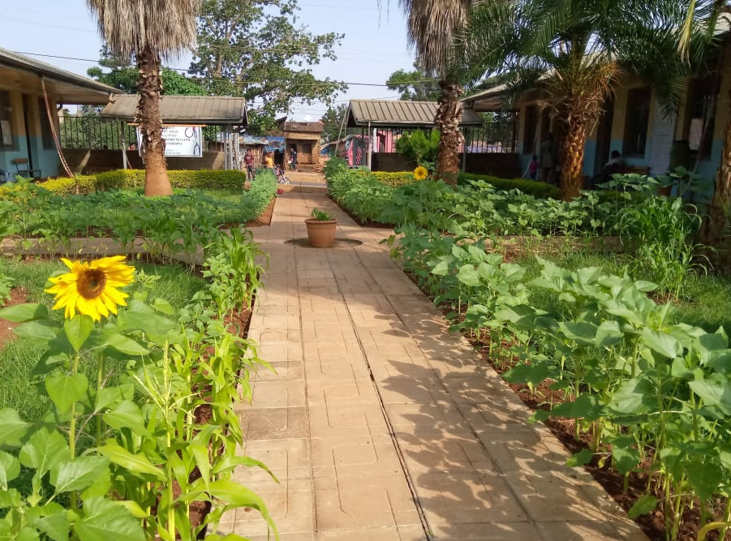
Cry of the earth
Attention for the nature
Dilla
Take care of garden

Slide 7
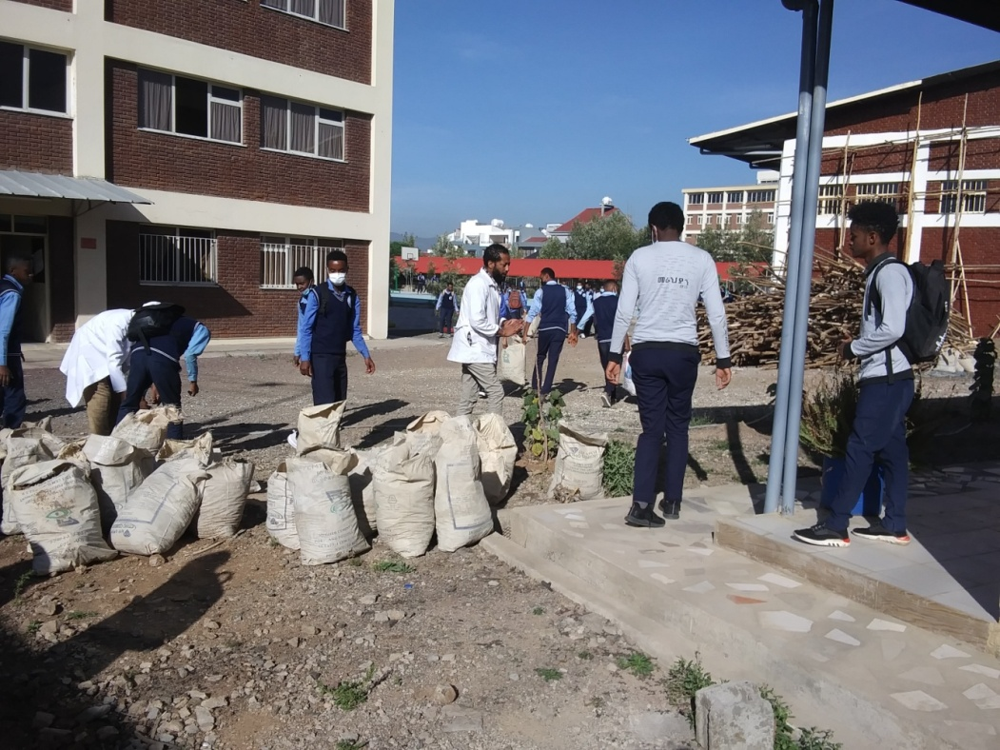
Cry of the earth
Bole
Attention for the nature
Soil for the trees

Slide 8
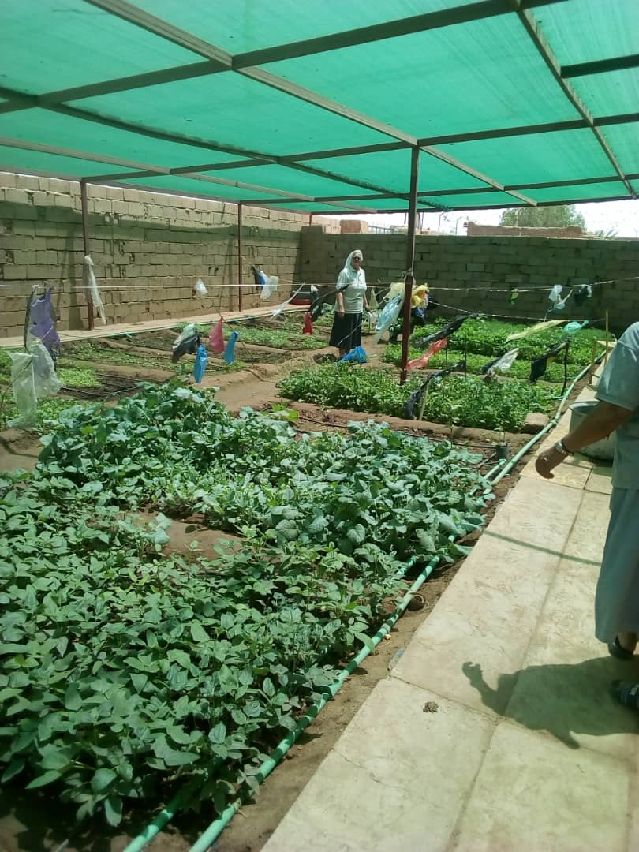
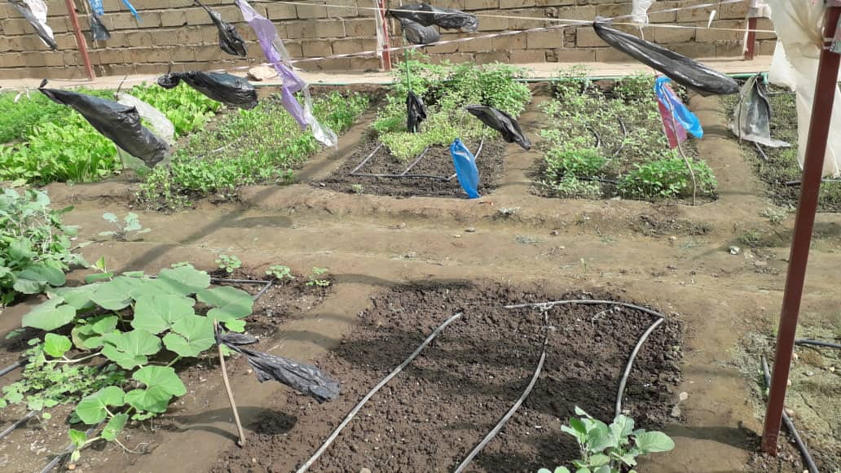
Cry of the earth
Kartoom
Take care of garden

Slide 9
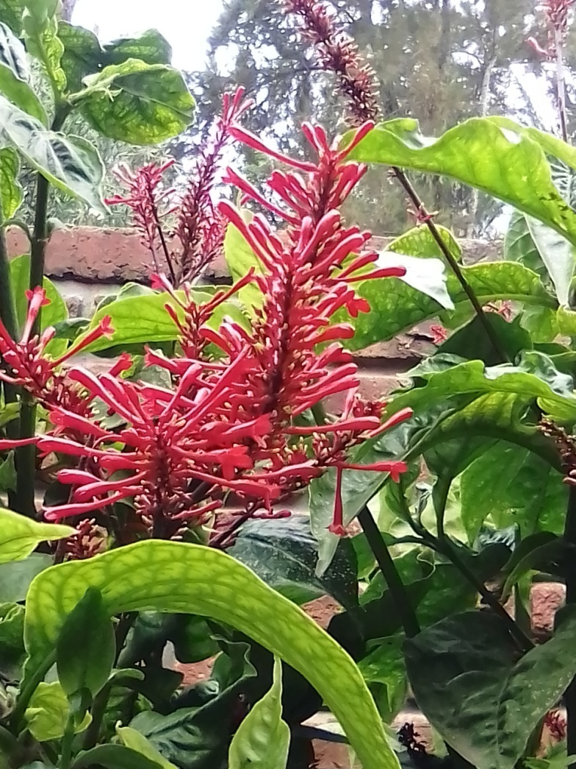
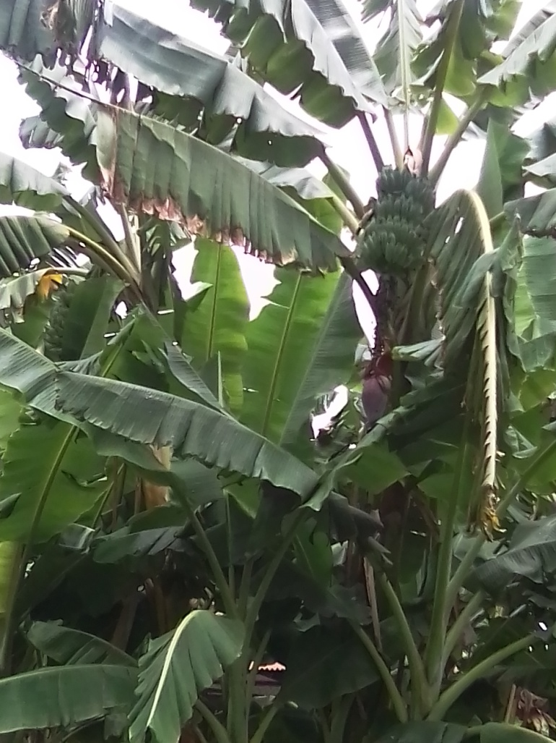
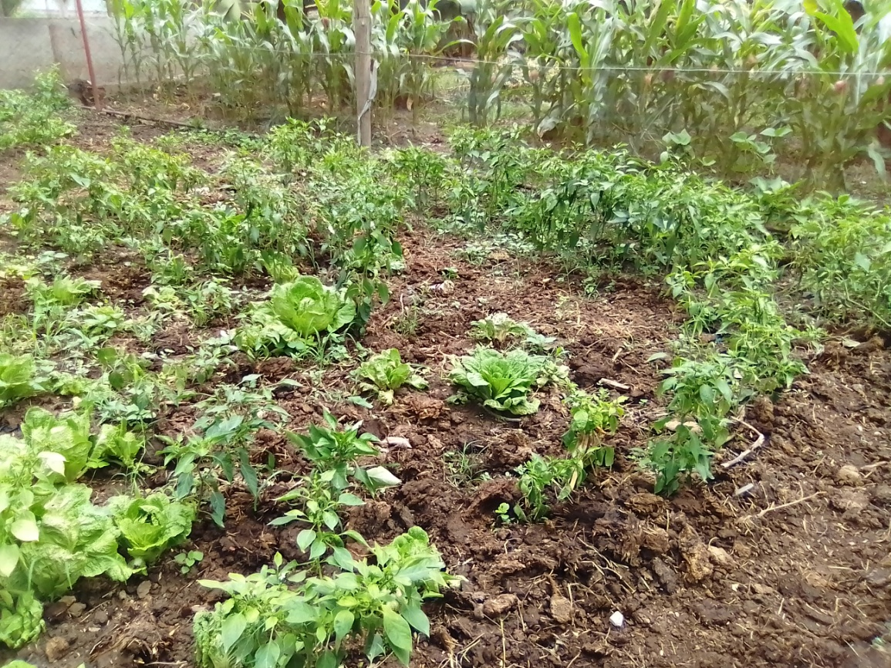
Cry of the earth
Biodiversity
Take care
of garden
Zway

Slide 10
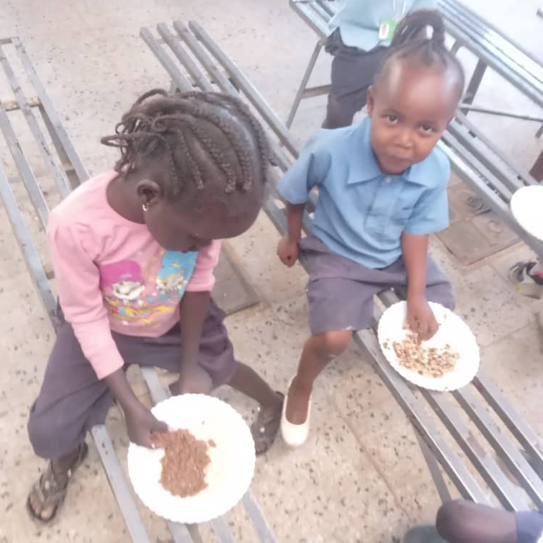
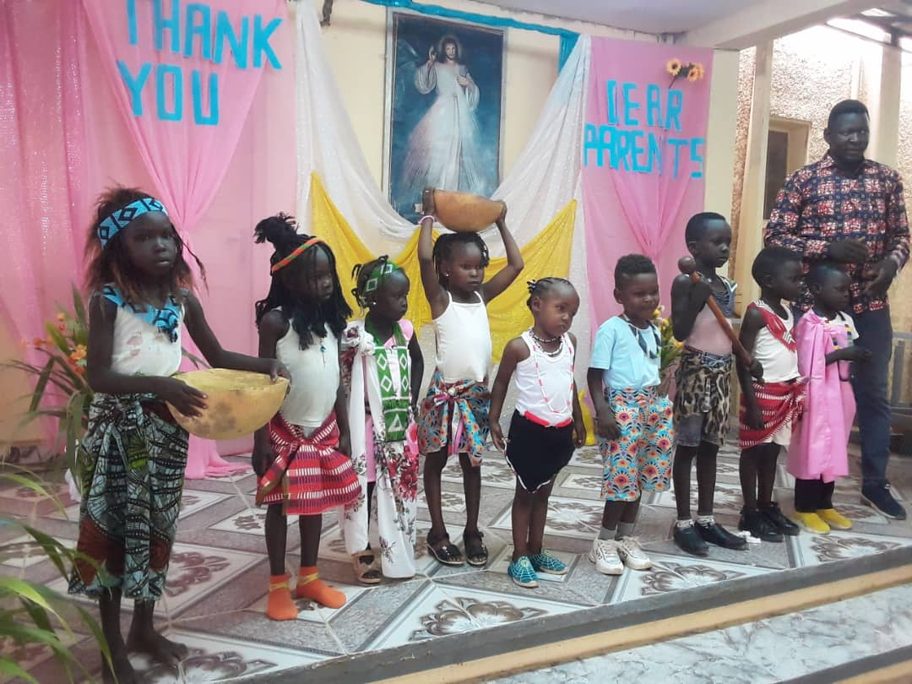
Cry
of the poor
Kartoom
Refugees attention and care

Slide 11
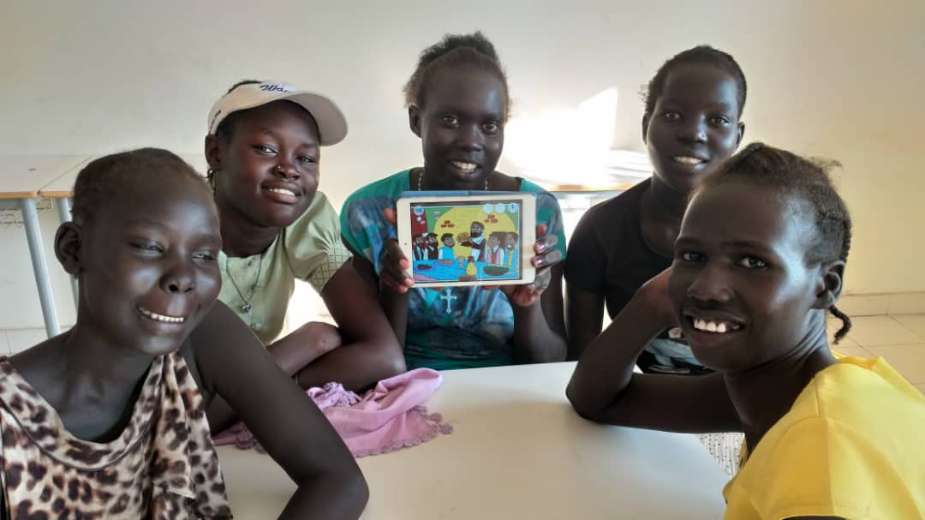
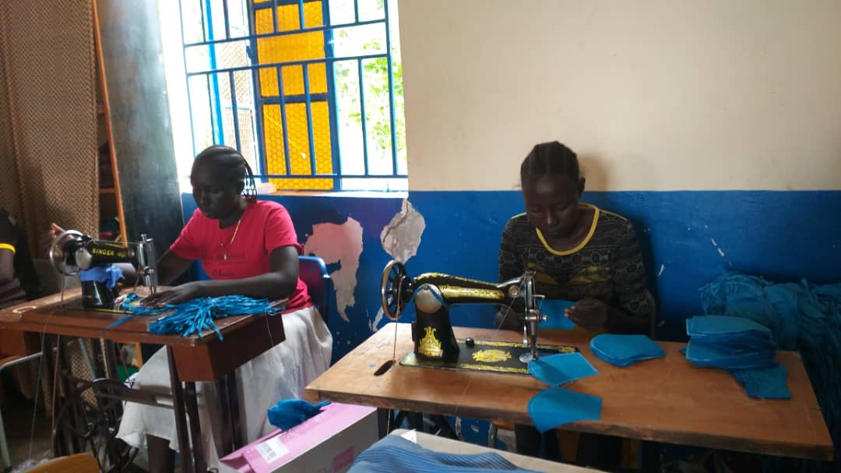
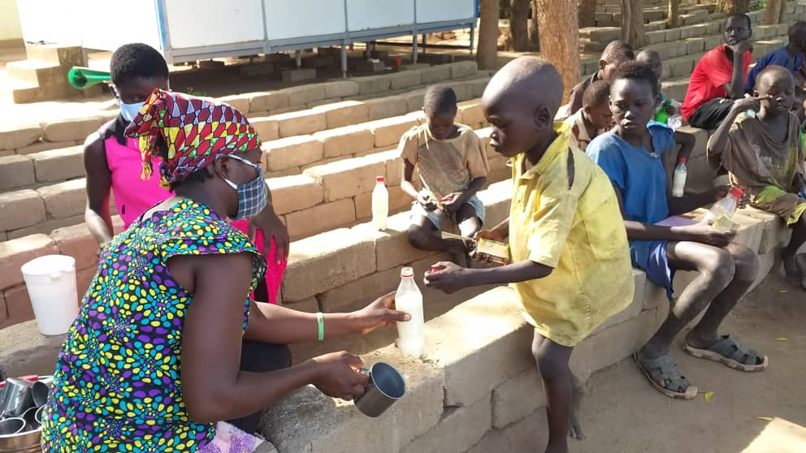
Cry
of the poor
Women Promotion
Tonj
Food provision

Slide 12
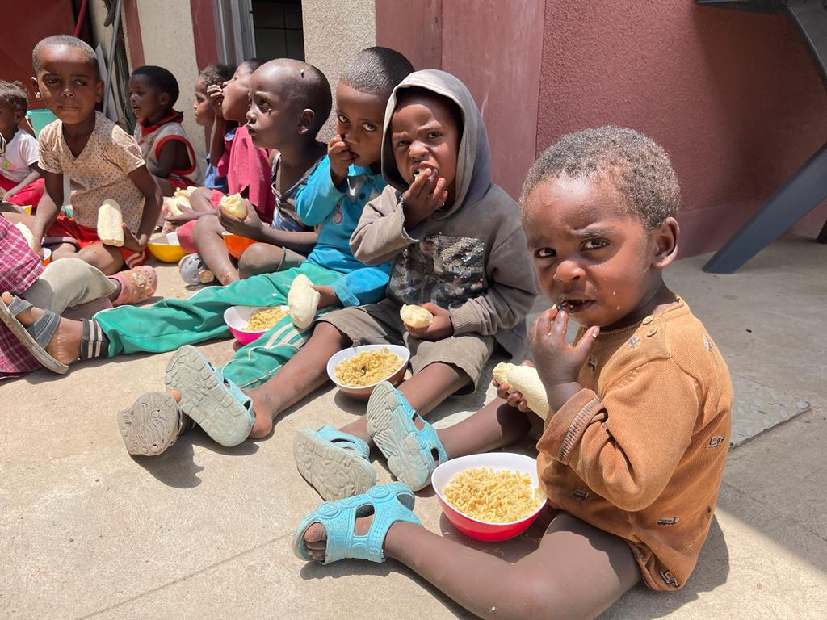
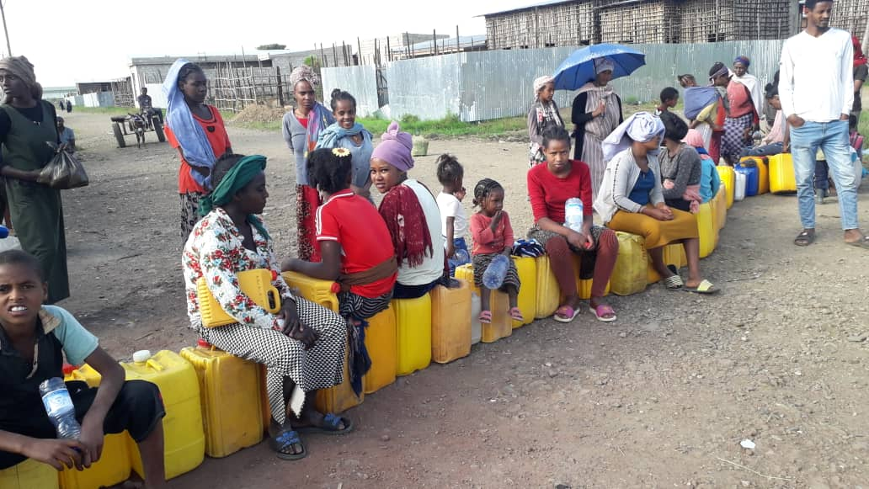
Cry
of the poor
Food provision
Gubrie
Water suppply

Slide 13
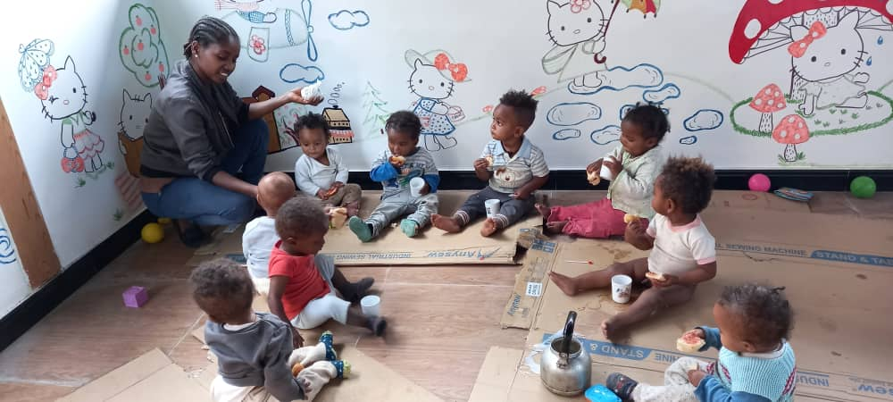
Cry
of the poor
Provincial House
Women Promotion and rights
Welcoming
House

Slide 14
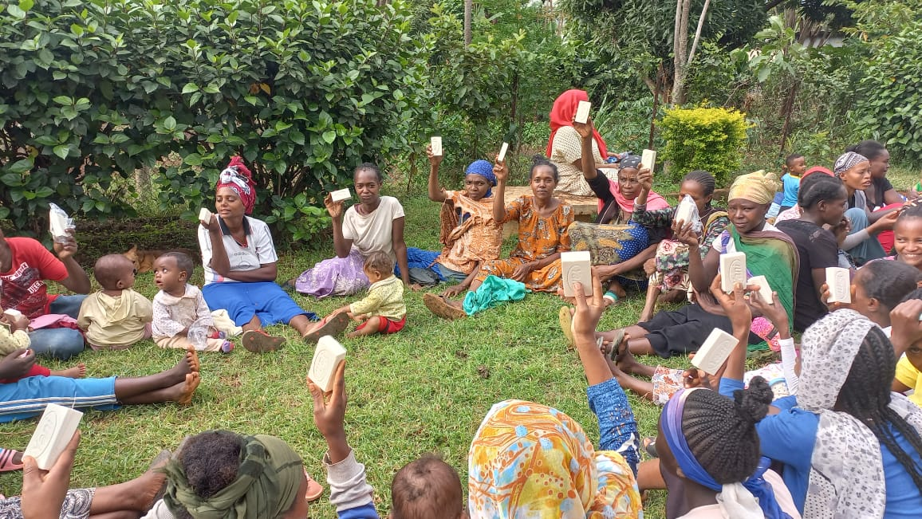
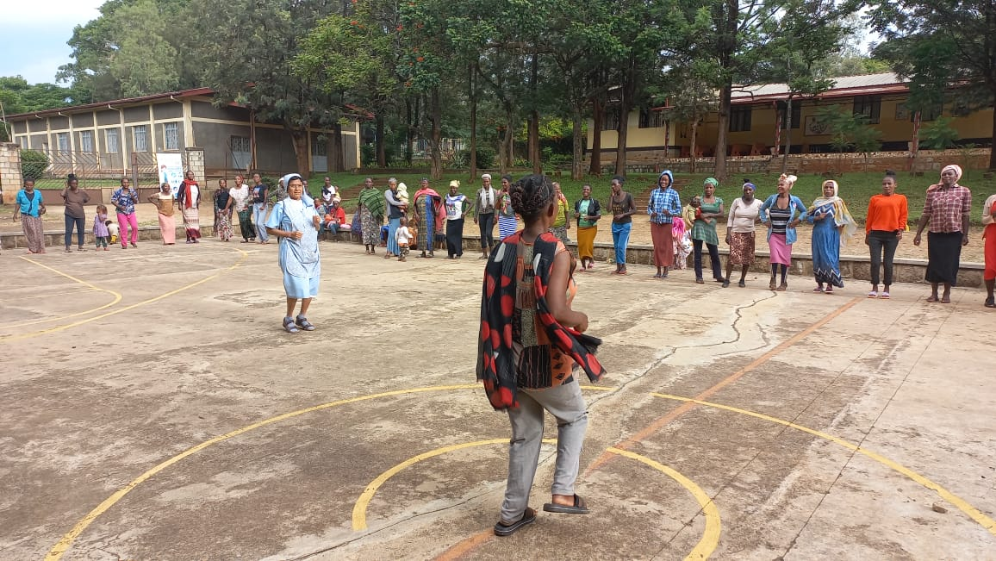
Cry
of the poor
Health care
Food and needs Provision
Dilla

Slide 15
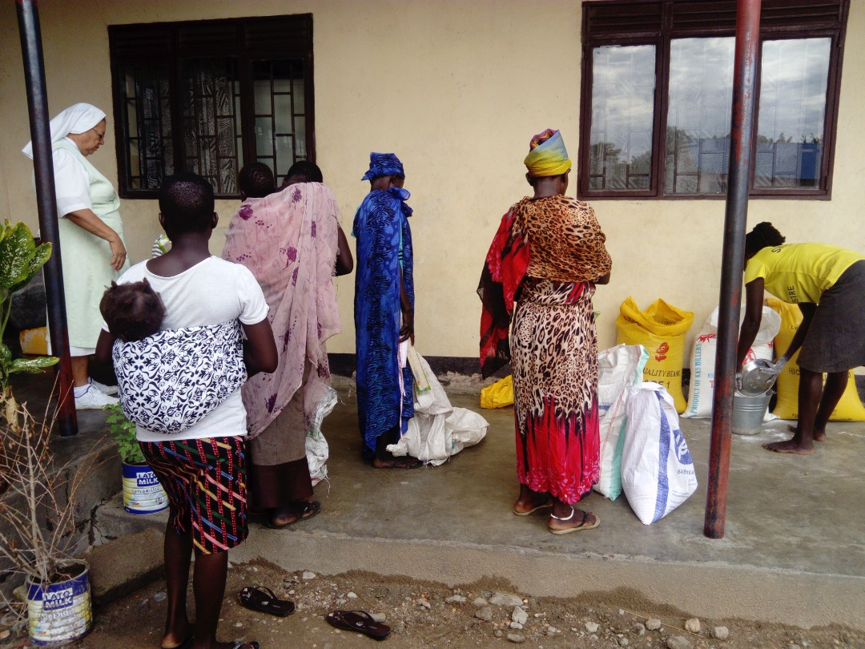
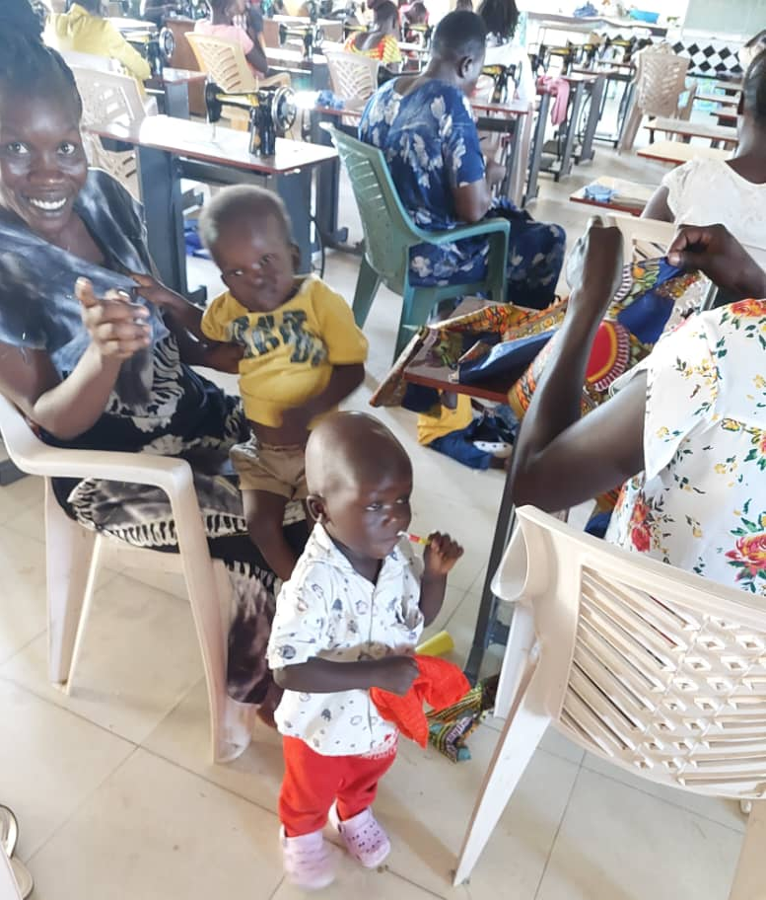
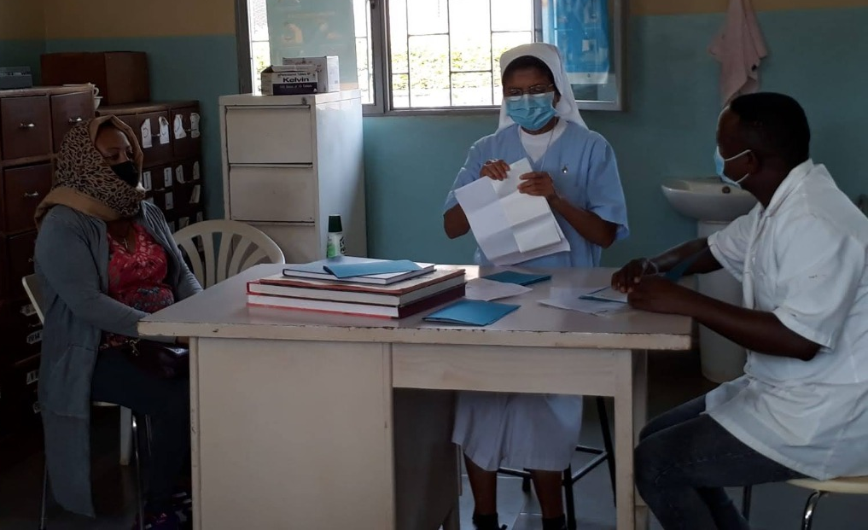
Food Provision
Cry
of the poor
Gumbo
Women Promotion
Health care

Slide 16
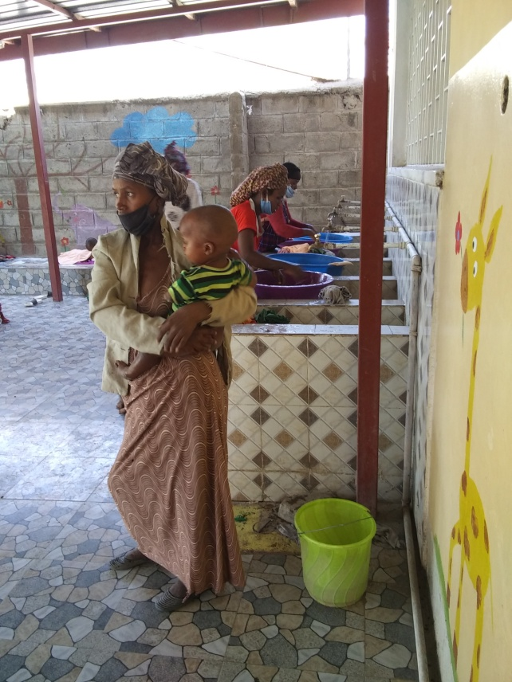
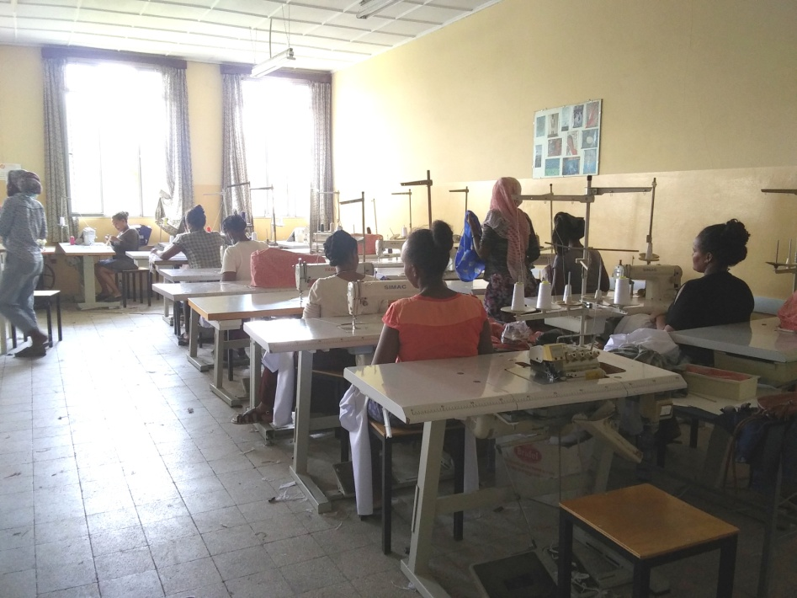
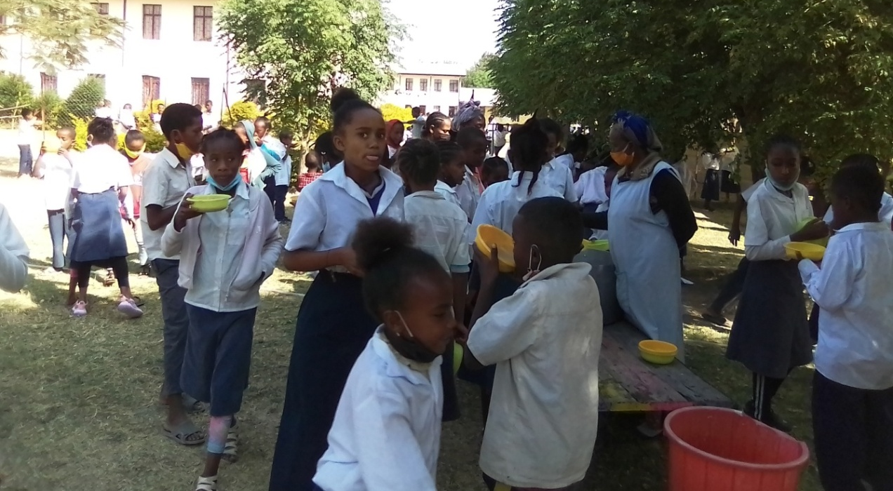
Cry
of the poor
Health care
Food Provision
Women Promotion
Zway

Slide 17
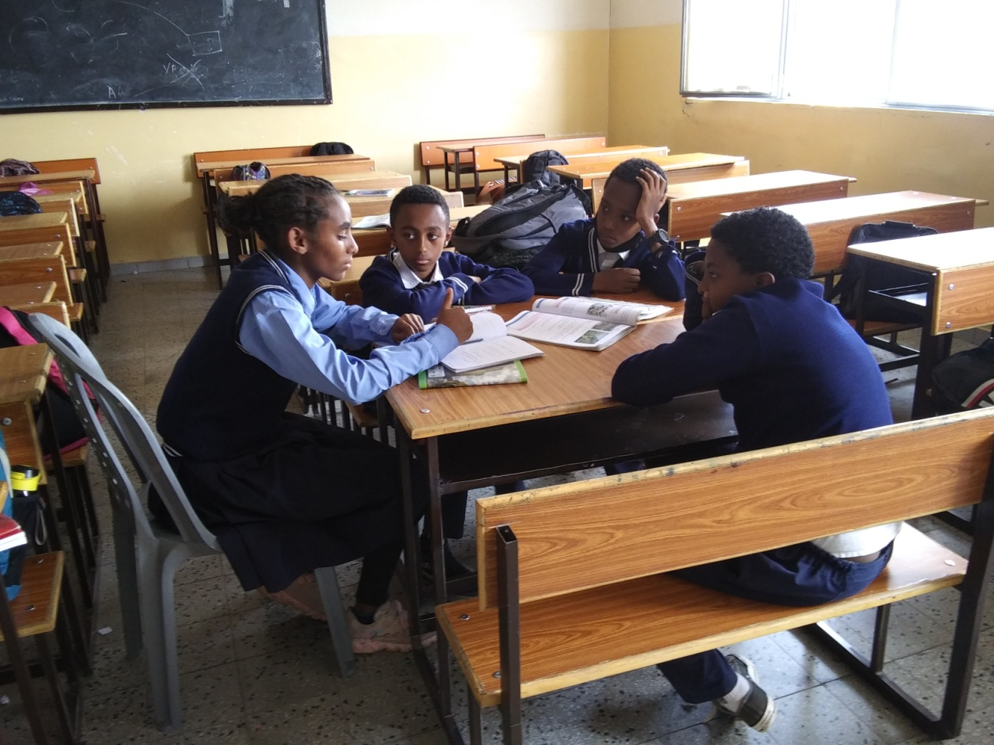
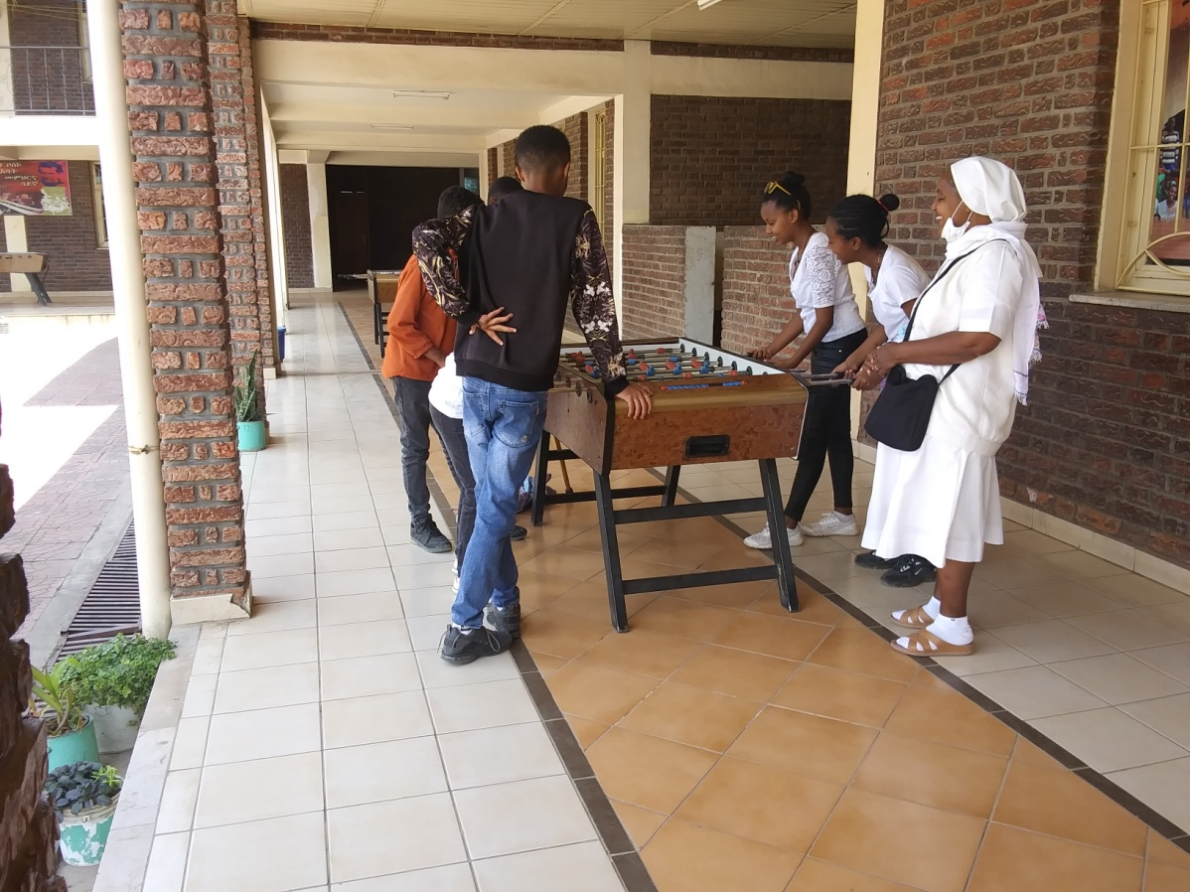
Volunteer service
Cry
of the poor
Women rights
Accompainment young people

Slide 18
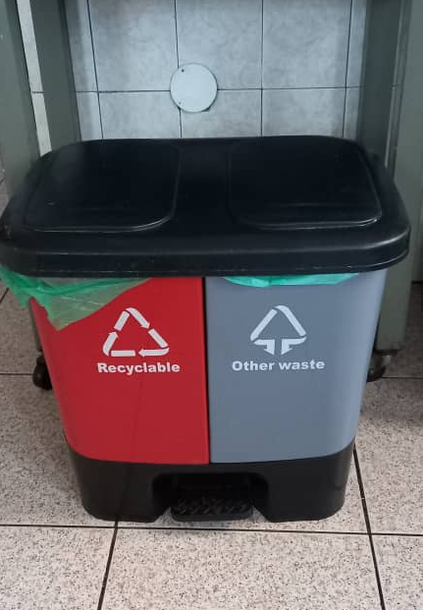
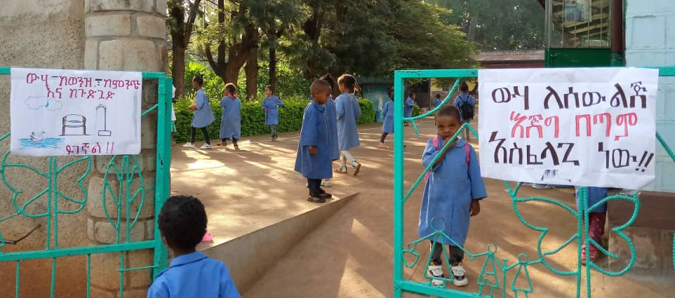
The adoption a sustainable Lifestyles
Bole
Reuse
Provincial House
Compost place preparation
Recycle
Dilla

Slide 19
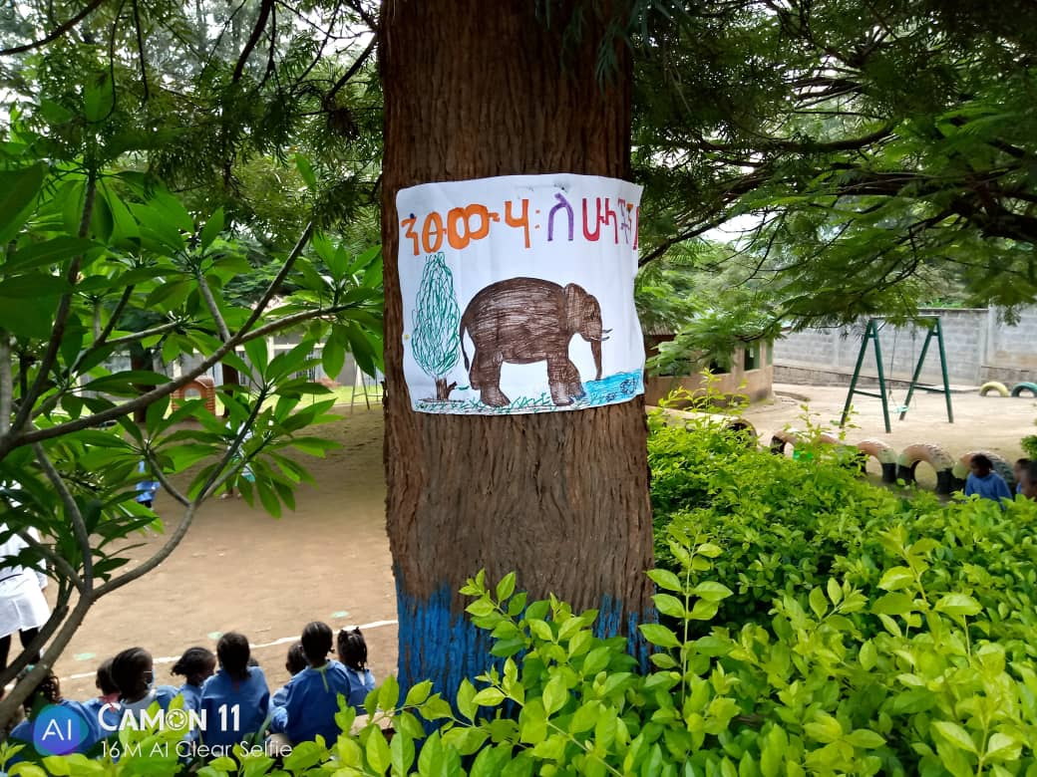
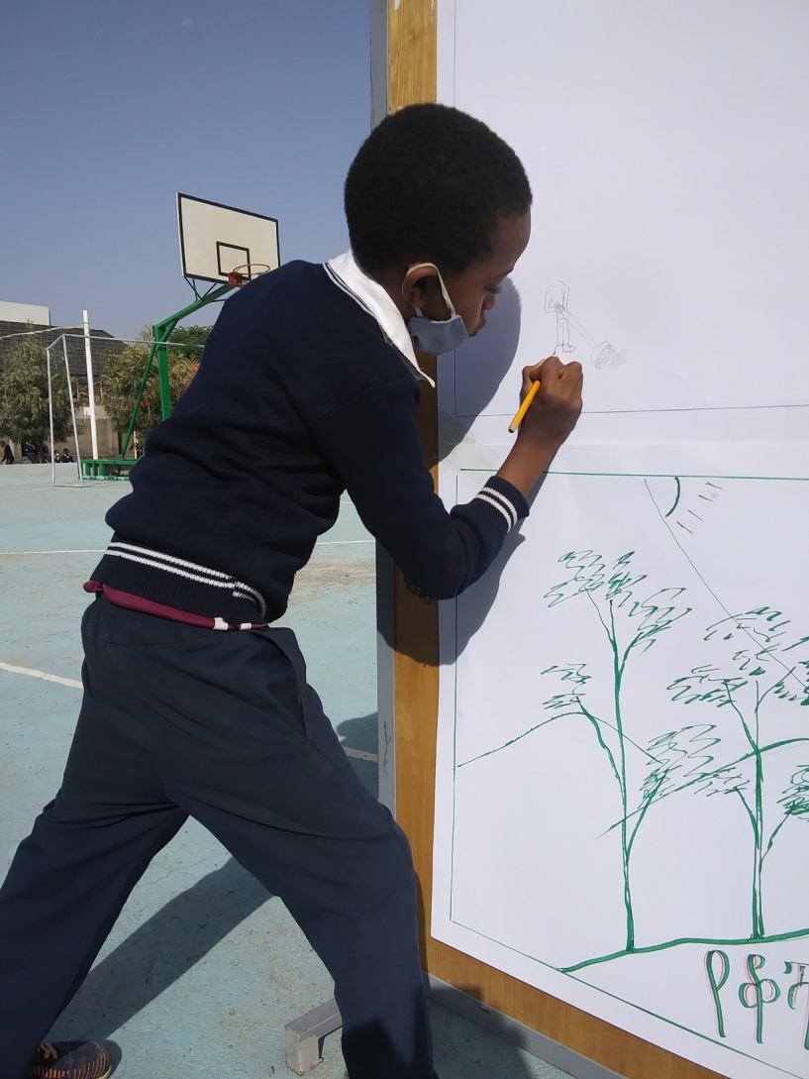
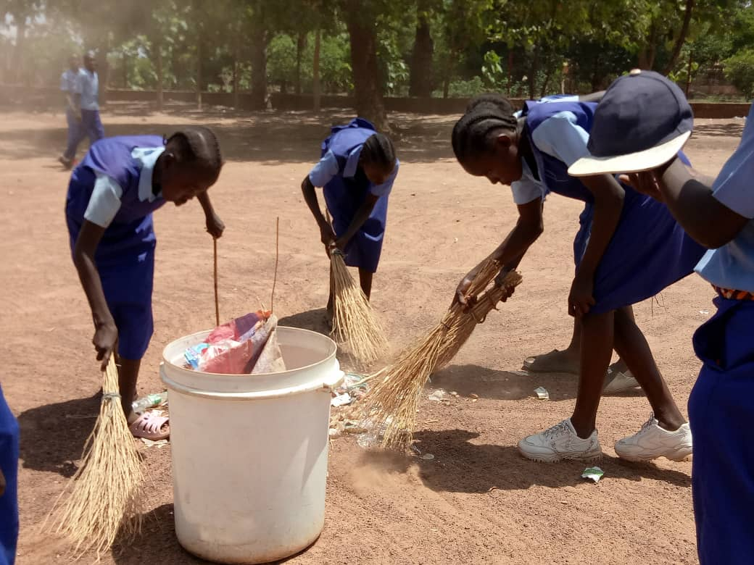
Dilla
Wau
Bole
Ecological Education

Slide 20
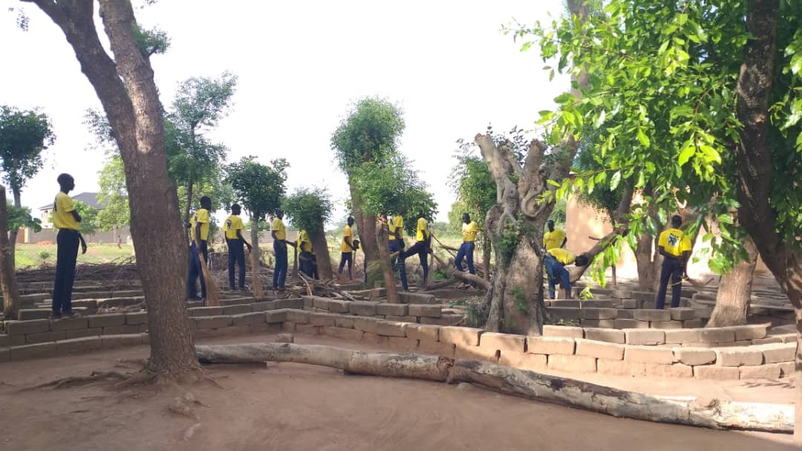
Ecological Education
Gumbo
Tonj

Slide 21
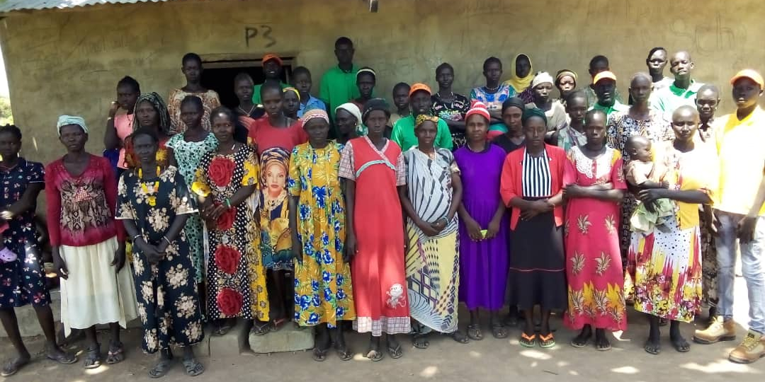
Bole
Community Engagement and Participatory Action
Tonj

Slide 22
Ecological
Spirituality
AES Proposal Pastoral youth Ministry for Educating Communities

